Slide 1
Assessing the role of COMMUNITY--led organizations on the financial and emotional well-being of FEMALE SEX WORKERS: EVIDENCE from the AVAHAN project in India
Contributors
Dr. Sangram Kishor Patel
Dr. Saradiya Mukherjee
Dr. Bidhubhusan Mahapatra
Dr. Madhusudana Battala
Dr. Niranjan Saggurti
HIV and AIDS Program, Population Council, New Delhi, India
10th IAS Conference on HIV Science (IAS 2019), Mexico City, Mexico
21-24 July 2019

Slide 2
Journey of Avahan program (2003-17)
Started as a scaled-up HIV prevention program across 6 high prevalence states of India
Phase 1: 2003-2008
BMGF launched Avahan in 2003 with targeted HIV prevention services
Phase 2: 2009-2013
Community mobilization; Community organization (CO) mentoring
Phase 3: 2014-2017
Transfer ownership to communities & address vulnerabilities (including financial vulnerability) through CO institutional building for sustained epidemic impact

Slide 3
Avahan 3 program model
1
2
3
4
PILLARS
Organizational development
Financial security
Social protection
Crisis
response
AIM
Improve governance, program and financial management
Create an enabling environment for key population
Enhance financial literacy and inclusion
Enable access social welfare schemes
Sustained HIV risk reduction
CORE ACTIVITIES
Leadership training
Skill building
Periodic assessment
Resource mobilization
Advocacy and networking
Liaisioning with financial institutions
Financial literacy training
Workshops on financial products
Advocacy with Government departments
Processed application through unified help desk
Legal awareness trainings
Quick rapid action team
Helpline
Para-legal services
Free legal aid
Notes:
In organizational development, the program focused to strengthen the capacity of community organizations: in their governance, management, advocacy networking, resource mobilizations etc.
In financial security was calculated considering factors like having a savings account, investment in schemes, insurance products, had an alternative source of income, and had not taken any loan from informal sources etc.

Slide 4
Key question
Did improvement in institutional strength empower FSWs by enhancing their financial security?

Slide 5
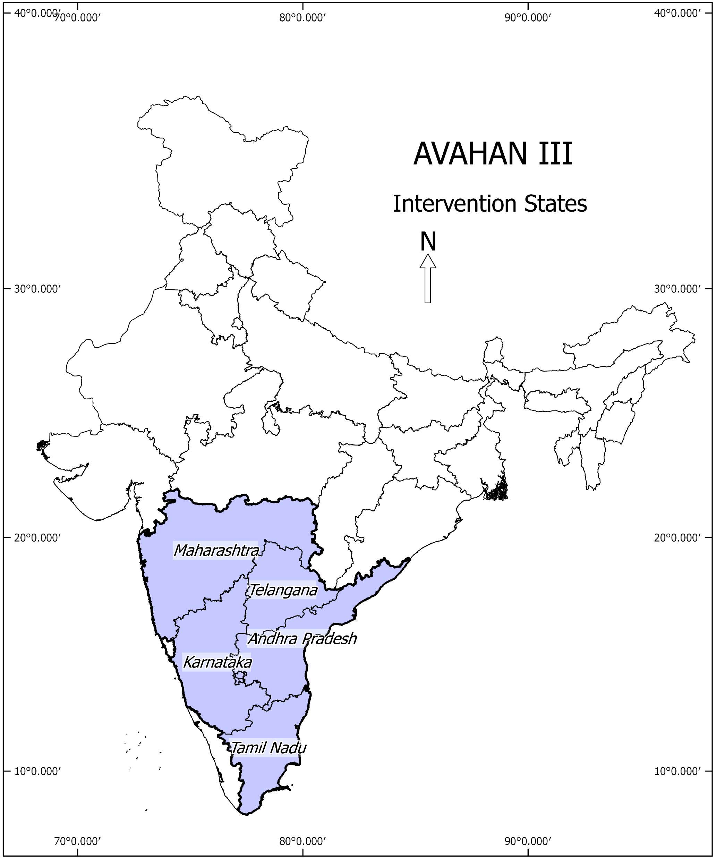
Data and Methods
Study area: Five states (4 southern and 1 western) of India
Data: Panel data (Baseline in 2015 and End line in 2017) from 38 COs
Sample size: 2085 FSWs
Assessment methodology:
FSWs: Structured interviews
COs: Structured interviews with leaders, participatory methods and verification of records/Documents
Measures used:
CO strength
Financial security
Self-efficacy, Self confidence and Individual agency
Analytical approach: Panel data analyses
Notes:
Nearly 1 lakh KPs were covered across 38 COs.

Slide 6
Average age is 35 years Most of the FSWs are currently married, literate, mobile for sex work and primarily soliciting clients from homes
Socio-demographic profile

Slide 7
CO Strength has improved over intervention period
CO strength is a reflection of how COs have performed in different dimensions critical to their functionality and sustainability
CO strength
High strength COs
Resource Mobilization
Advocacy and networking
Governance
CO strength measurement indicators:
Multi-dimensional: 6 dimensions and 32 indicators
Each dimensions were assigned equal weight and indicators within each dimension were assigned equal weight
Strength score was categorized into 2 categories: High and Low
Financial Management
Program Management
Program Monitoring
Notes:
CO strength as measured during Baseline and End-line: Strength score was categorized into 2 categories: High and Low based on the median split

Slide 8
Significant improvement (4 times) in Financial Security
Baseline | Financial security Indicators |  | End line
49% |  | Financial security | 82%
13% |  | Invested in Insurance | 44%
4% |  | Had not taken any loan from informal sources | 6%
32% |  | Invested money in saving schemes | 61%
70% |  | Have a savings account | 84%
53% |  | Have other income besides sex work | 71%
AOR: 4.0 (3.5-4.7)***
Note: Financial security, a composite index, derived by combining various financial service related indicators
Notes:
Financial security, a composite index, derived by combining various financial service related indicators (Based on composite score and median split, Low and High Financial security was categorized)
Savings and investments improved by three times from baseline to end-line
On an average, FSWs saved nearly ₹ 4,000 in SHG, and micro-finance
FSWs make on an average, 2 transactions at the bank in a quarter
82% do not need permission from someone to withdraw money
FSWs took loan mainly for personal or family member’s health issues (~ 8%)
4% took a new loan to repay an old loan

Slide 9
Financial security improved as the CO strength improved or remained high at both baseline and end-line
Improved vs Declined/Remained low: 1.17 (0.72-1.92)*
Remained high vs Declined/Remained low : 2.52 (1.55-4.11)***
Declined/Remained low CO strength Improved CO strength Remained high CO strength
Notes:
CO strength as measured during End-line

Slide 10
Enhanced financial security empowered female sex workers
AOR (95% CI)
Reference
1.4 (0.9-2.2)
2.7 (1.9-3.9)***
1.6 (1.1-2.3)***
Reference
0.9 (0.6-1.5)
1.9 (1.4-2.6)***
2.0 (1.5-2.8)***
Reference
1.1 (0.7-1.6)
2.2 (1.6-3.1)***
1.4 (1.0-1.9)***
AOR: Adjusted Odds Ratio; AORs are adjusted for age, education, currently married, typology and living arrangements; *** indicate significance at 1%.
Notes:
Self-efficacy is a FSW’s belief in his or her ability to succeed in a particular situation (For example condom use or health services utilization).
Condom use: How frequently were you able to insist on using a condom with each client/partner under following circumstances (Always):
Even when he got angry with you
Even when he offered you more money for sex without a condom
Even when you have consumed alcohol
Health services utilization: .How confidently you have gone to the government health clinic to get health services you needed even if the health workers there treated you badly? (Always)
2.How confidently have gone to the government health clinic to get the health services you needed even if the health workers know you are a sex worker? (Always)
3.How confidently you have gone to the other health clinics to get reproductive health services you needed even if the health workers there treated you badly? (Always)
Individual agency: agency is the capacity of individuals to act independently and to make their own free choices
In past one year, when you are tired, how often do you take clients when you do not want to?
In the last one month, have you turned away clients when they refused to use a condom during sex?
Self-confidence: self-confidence self-assurance in one's personal judgment, ability, power, etc. One's self confidence increases from experiences of having mastered particular activities
How confident do you feel speaking your opinion in any training or CO meeting?
How confident do you feel when you have to talk to a bank officer/manager?
How confident do you feel when you have to talk to a CO Manager?
How confident do you feel when you have to talk to a Field worker/ Champion?
How confident are you that you can go to a PDS service to avail services?
How confident do you feel in giving advice to a fellow sex worker in accessing HIV services?

Slide 11
Conclusions
The program has demonstrated a significant increase in CO strength, which ultimately helped to improve the financial security among FSWs.
Enhanced financial security is key to empower (e.g. the self-efficacy, self confidence and individual agency) FSWs.
There is a need to sustain the increased strength of COs that enables to address FSWs’ vulnerabilities and build their empowerment.
Notes:
Intervention to strengthen key population led COs showed significant improvement in their strength, which ultimately helping to improve the financial security among FSWs.
Enhanced financial security is key to improve the self-efficacy, self confidence and individual agency among FSWs.

Slide 12
For more information on this presentation, please write to:
skpatel@popcouncil.org

Slide 13
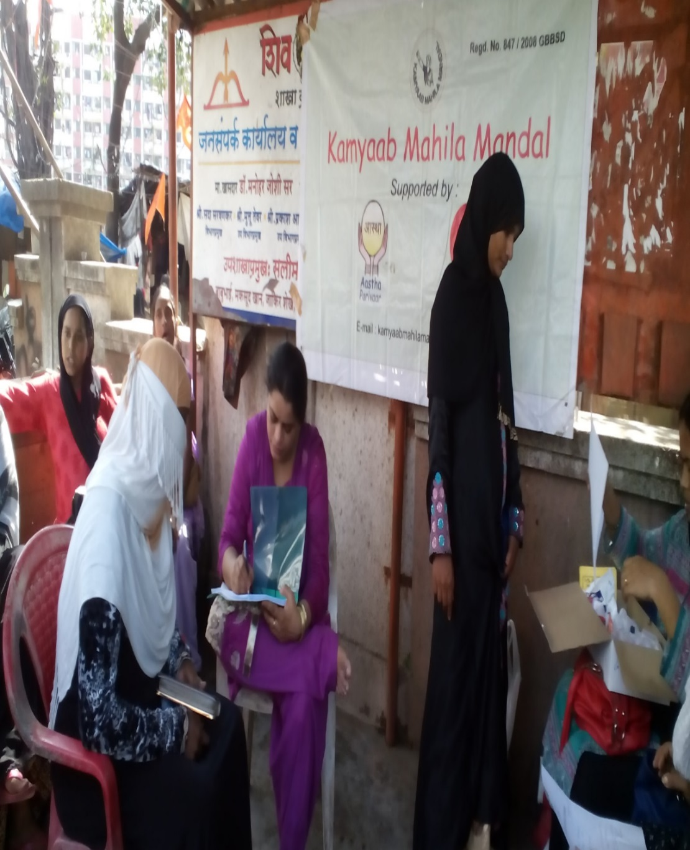
Thanks !

